Slide 1

Artificial Intelligence(AI101B) Even Semester Session 2024-25
Tannoo Shukla (202410116100220)
Tannu Modanwal (202410116100221)
Tanya Singh (202410116100222)
Trapti Rajput (202410116100224)

Slide 2
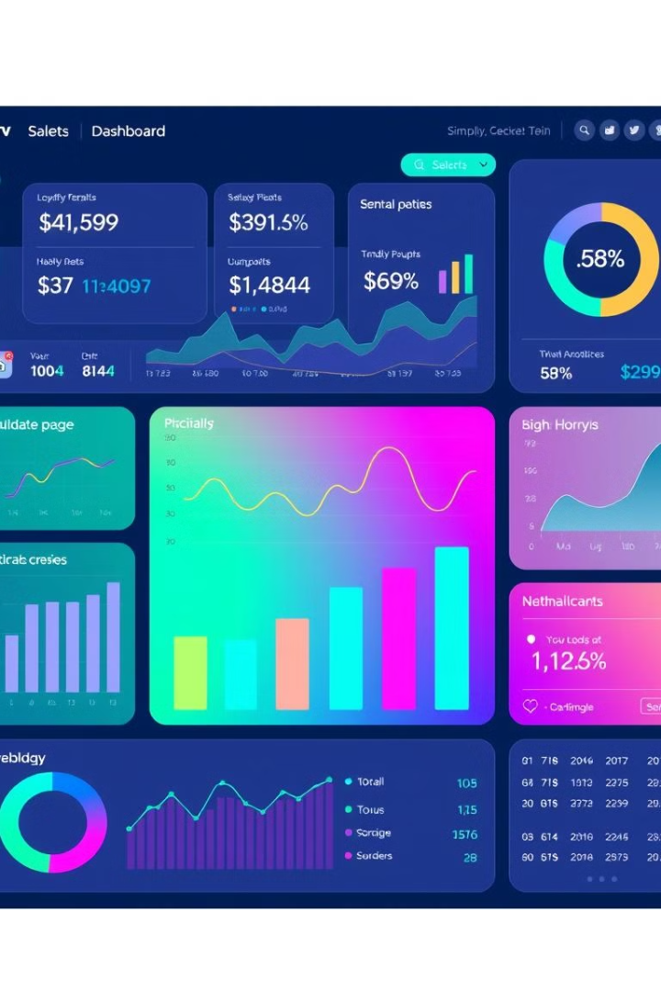
Sales Data Visualization: Transforming Numbers into Insights
In today's data-driven world, the ability to transform raw sales figures into actionable business intelligence is paramount. Sales data visualization bridges the gap between data complexity and strategic understanding, empowering decision-makers with clear, compelling visuals. By turning complex datasets into easily digestible formats, businesses can unlock insights, optimize performance, and drive growth.
This presentation will guide you through the essentials of sales data visualization, demonstrating how it can revolutionize your approach to sales analytics and business strategy. We'll explore key techniques, illustrate the power of effective data representation, and highlight how visualization.

Slide 3
Presentation Objectives
1
Demonstrate the Power
2
Explore Key Techniques
Illustrate the transformative impact of sales data visualization on business intelligence and strategic decision-making.
Uncover effective methods for data representation that enhance understanding and insight extraction.
3
Drive Business Decisions
4
Methodological Approach
Showcase how visualizations serve as the catalyst for well-informed and strategic business choices.
Present our comprehensive approach for data analysis, from collection and preprocessing to visualization and insights.
Our goal is to equip you with the knowledge and tools to leverage sales data visualization effectively, enabling you to make data-driven decisions that drive business success. By the end of this presentation, you'll have a clear understanding of how to harness the power of visual data to unlock hidden opportunities and optimize your sales strategies.

Slide 4
Sales Trend Analysis
Identifying Patterns
Visualization Techniques
Uncover trends in historical sales performance, including revenue growth and seasonal fluctuations. Key aspects to consider include:
Effective visualizations for sales trend analysis include:
Line graphs illustrating sales performance over time
Comparison charts highlighting year-over-year growth
Year-over-year sales comparisons
Trend prediction models offering insights into future performance
Quarterly sales progression
Forecasting future sales trends
By visually representing sales data, businesses can quickly identify patterns, trends, and potential areas for improvement. This information can then be used to make informed decisions about resource allocation, marketing strategies, and sales targets.

Slide 5
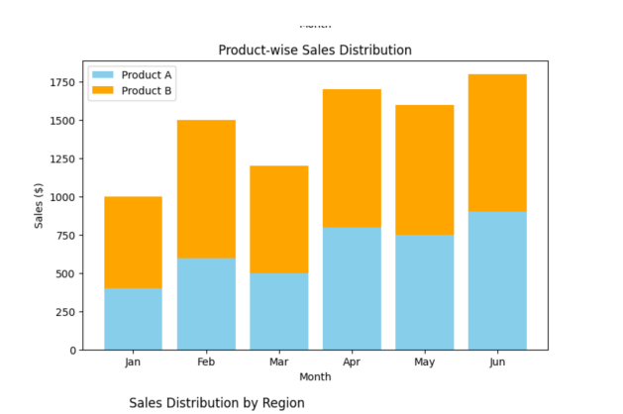
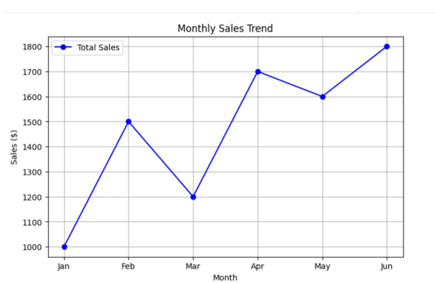
Analysis Results:
This research will provide valuable insights into how sales data visualization enhances decision-making, improves sales forecasting, and identifies business growth opportunities.

Slide 6
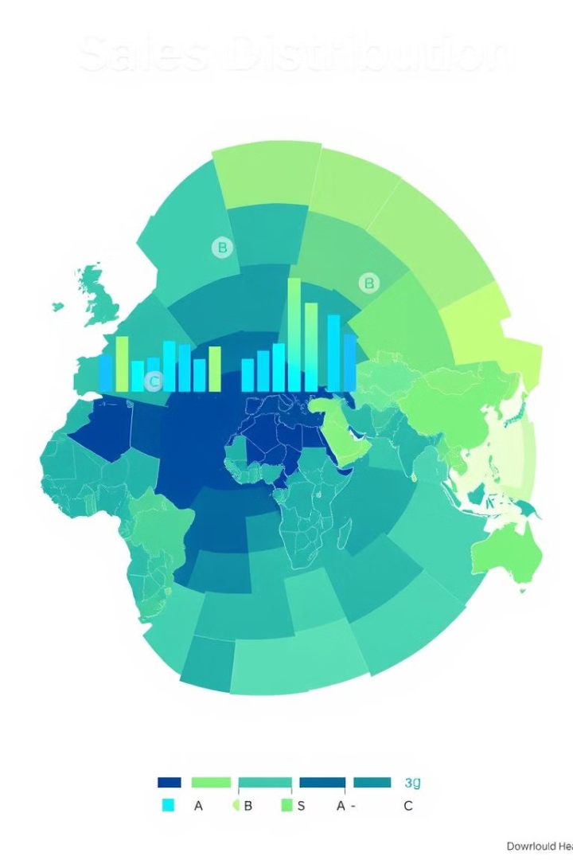
Comparative Analysis in Sales
Product Lines
Sales Regions
Compare the performance of different product lines to identify top-selling items and areas for improvement.
Evaluate sales performance across different regions to pinpoint high-performing areas and those needing more attention.
Time Periods
Analyze sales data across different time periods to identify seasonal trends and long-term growth patterns.
Comparative analysis enables businesses to benchmark performance, identify strengths and weaknesses, and make data-driven decisions to optimize sales strategies. Visual methods such as bar charts, heat maps, and scatter plots provide clear, actionable insights.

Slide 7
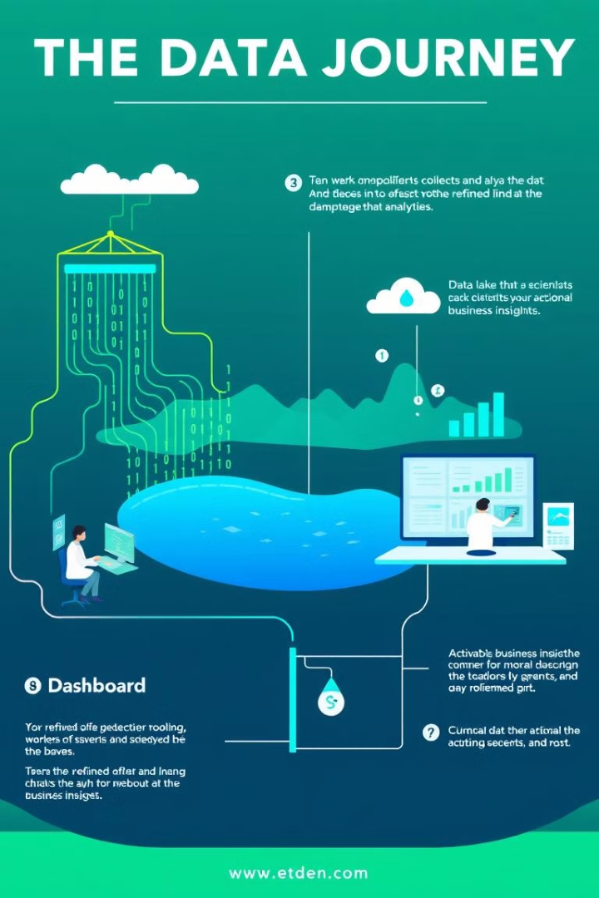




Methodology: Data Journey
Data Collection
Aggregate sales data from multiple sources, ensuring data quality and consistency. This includes CRM systems, point-of-sale data, and marketing automation platforms.
Data Preprocessing
Clean and normalize datasets, removing outliers and errors to ensure data accuracy. This step is critical for reliable analysis and visualization.
Advanced Analysis
Apply statistical modeling and predictive analytics techniques to uncover hidden patterns and trends. This may include regression analysis, time series forecasting, and machine learning algorithms.
Data Visualization
Transform data into interactive dashboards and visual reports that are easy to understand and navigate. Effective visualizations enable users to quickly identify key insights and trends.

Slide 8
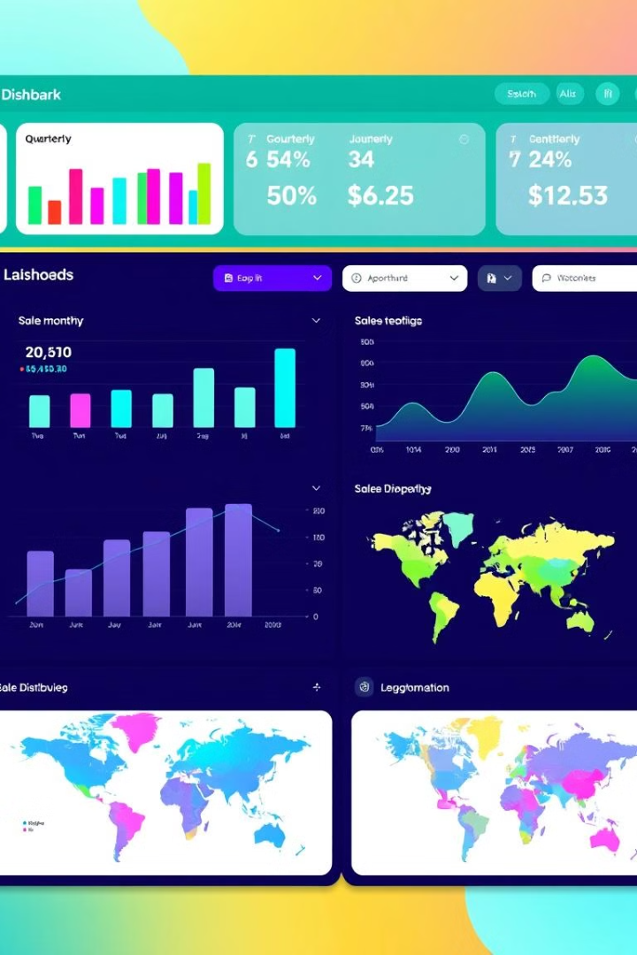




Data Visualization Techniques
Interactive Dashboards
Real-Time Updates
User-Friendly Interface
Ensure data is updated in real-time to provide the most current view of sales performance.
Design dynamic dashboards that allow users to explore data and drill down for more detailed insights.
Implement design principles that make the interface intuitive and easy to navigate.
Visual Hierarchy
Use color coding and visual hierarchy to highlight important data relationships and insights.

Slide 9



Business Insights and Decision Making
Growth Opportunities
1
Identify new markets, product lines, and customer segments with high growth potential.
Performance Bottlenecks
2
Pinpoint areas where sales performance is lagging and take corrective action.
Market Trends
3
Stay ahead of the curve by understanding evolving market dynamics and customer preferences.
By translating visualizations into strategic actions, businesses can make data-driven decisions that drive revenue growth and improve profitability. This includes supporting executive decision-making processes and enabling data-driven strategic planning.

Slide 10

Conclusion: The Power of Visual Data
Simplify Complexity
Faster Decisions
Uncover Opportunities
Visualization simplifies complex information, making it easier to understand and act upon.
Enables faster decision-making by providing quick access to key insights and trends.
Uncovers hidden business opportunities by revealing patterns and relationships in sales data.
In conclusion, visualization transforms raw data into strategic insight, enabling businesses to make informed decisions and drive growth. The future of sales analytics lies in more interactive and predictive insights, empowering businesses to stay ahead in a competitive landscape.

Slide 11
Thank You

